Slide 1
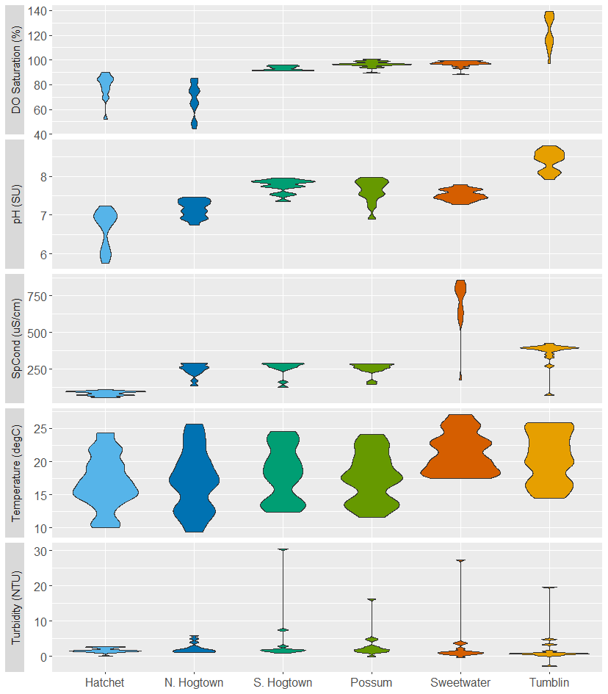
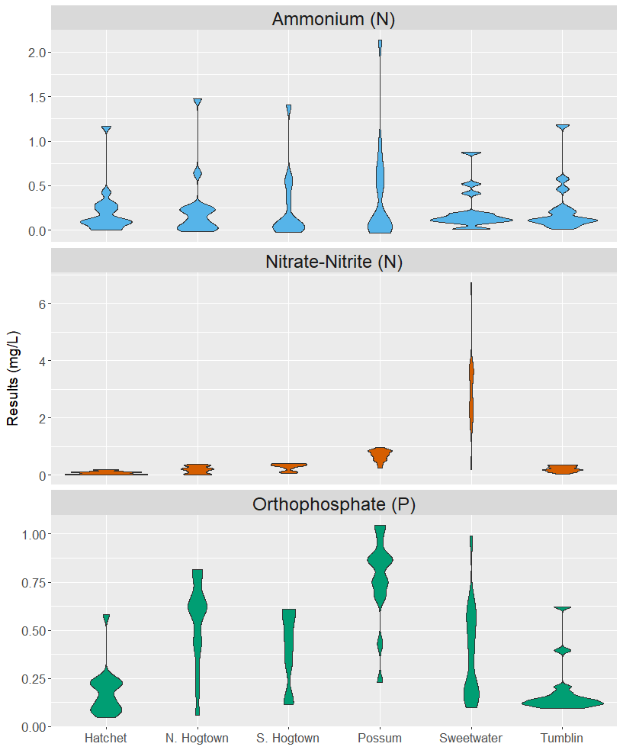
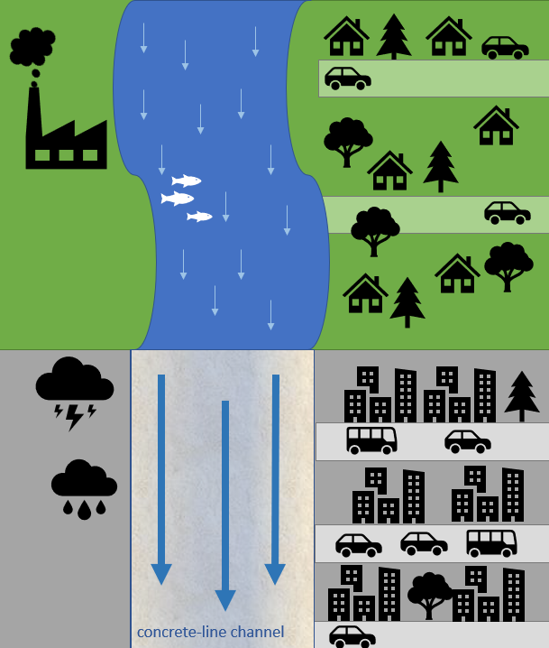
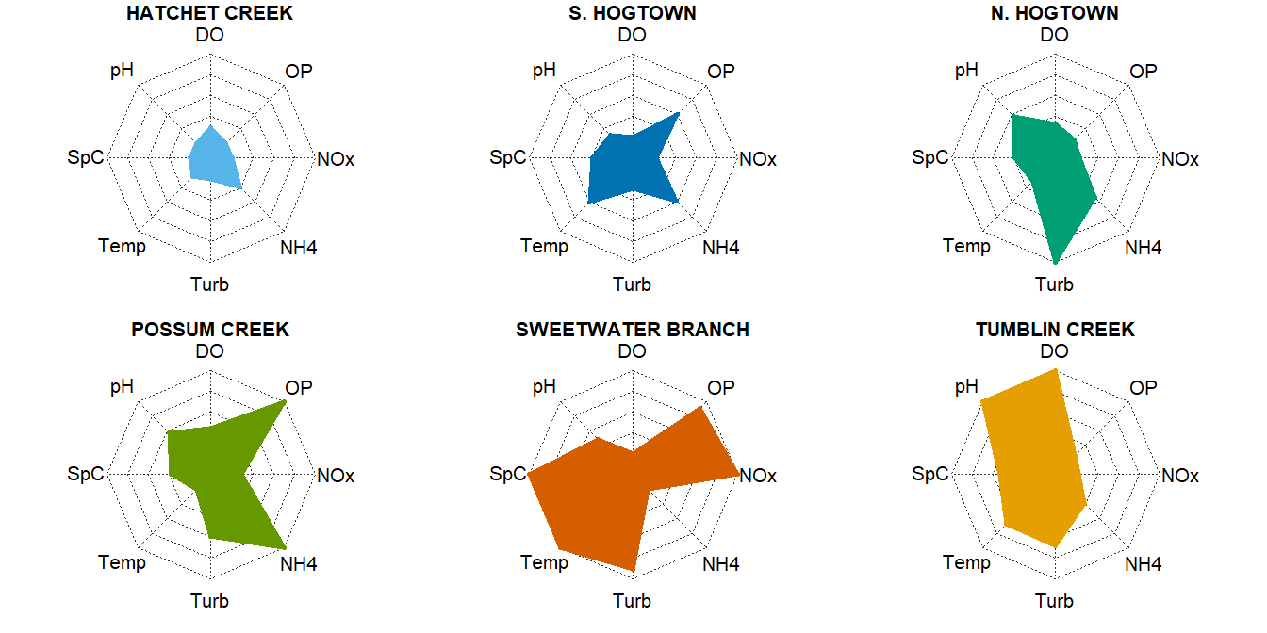

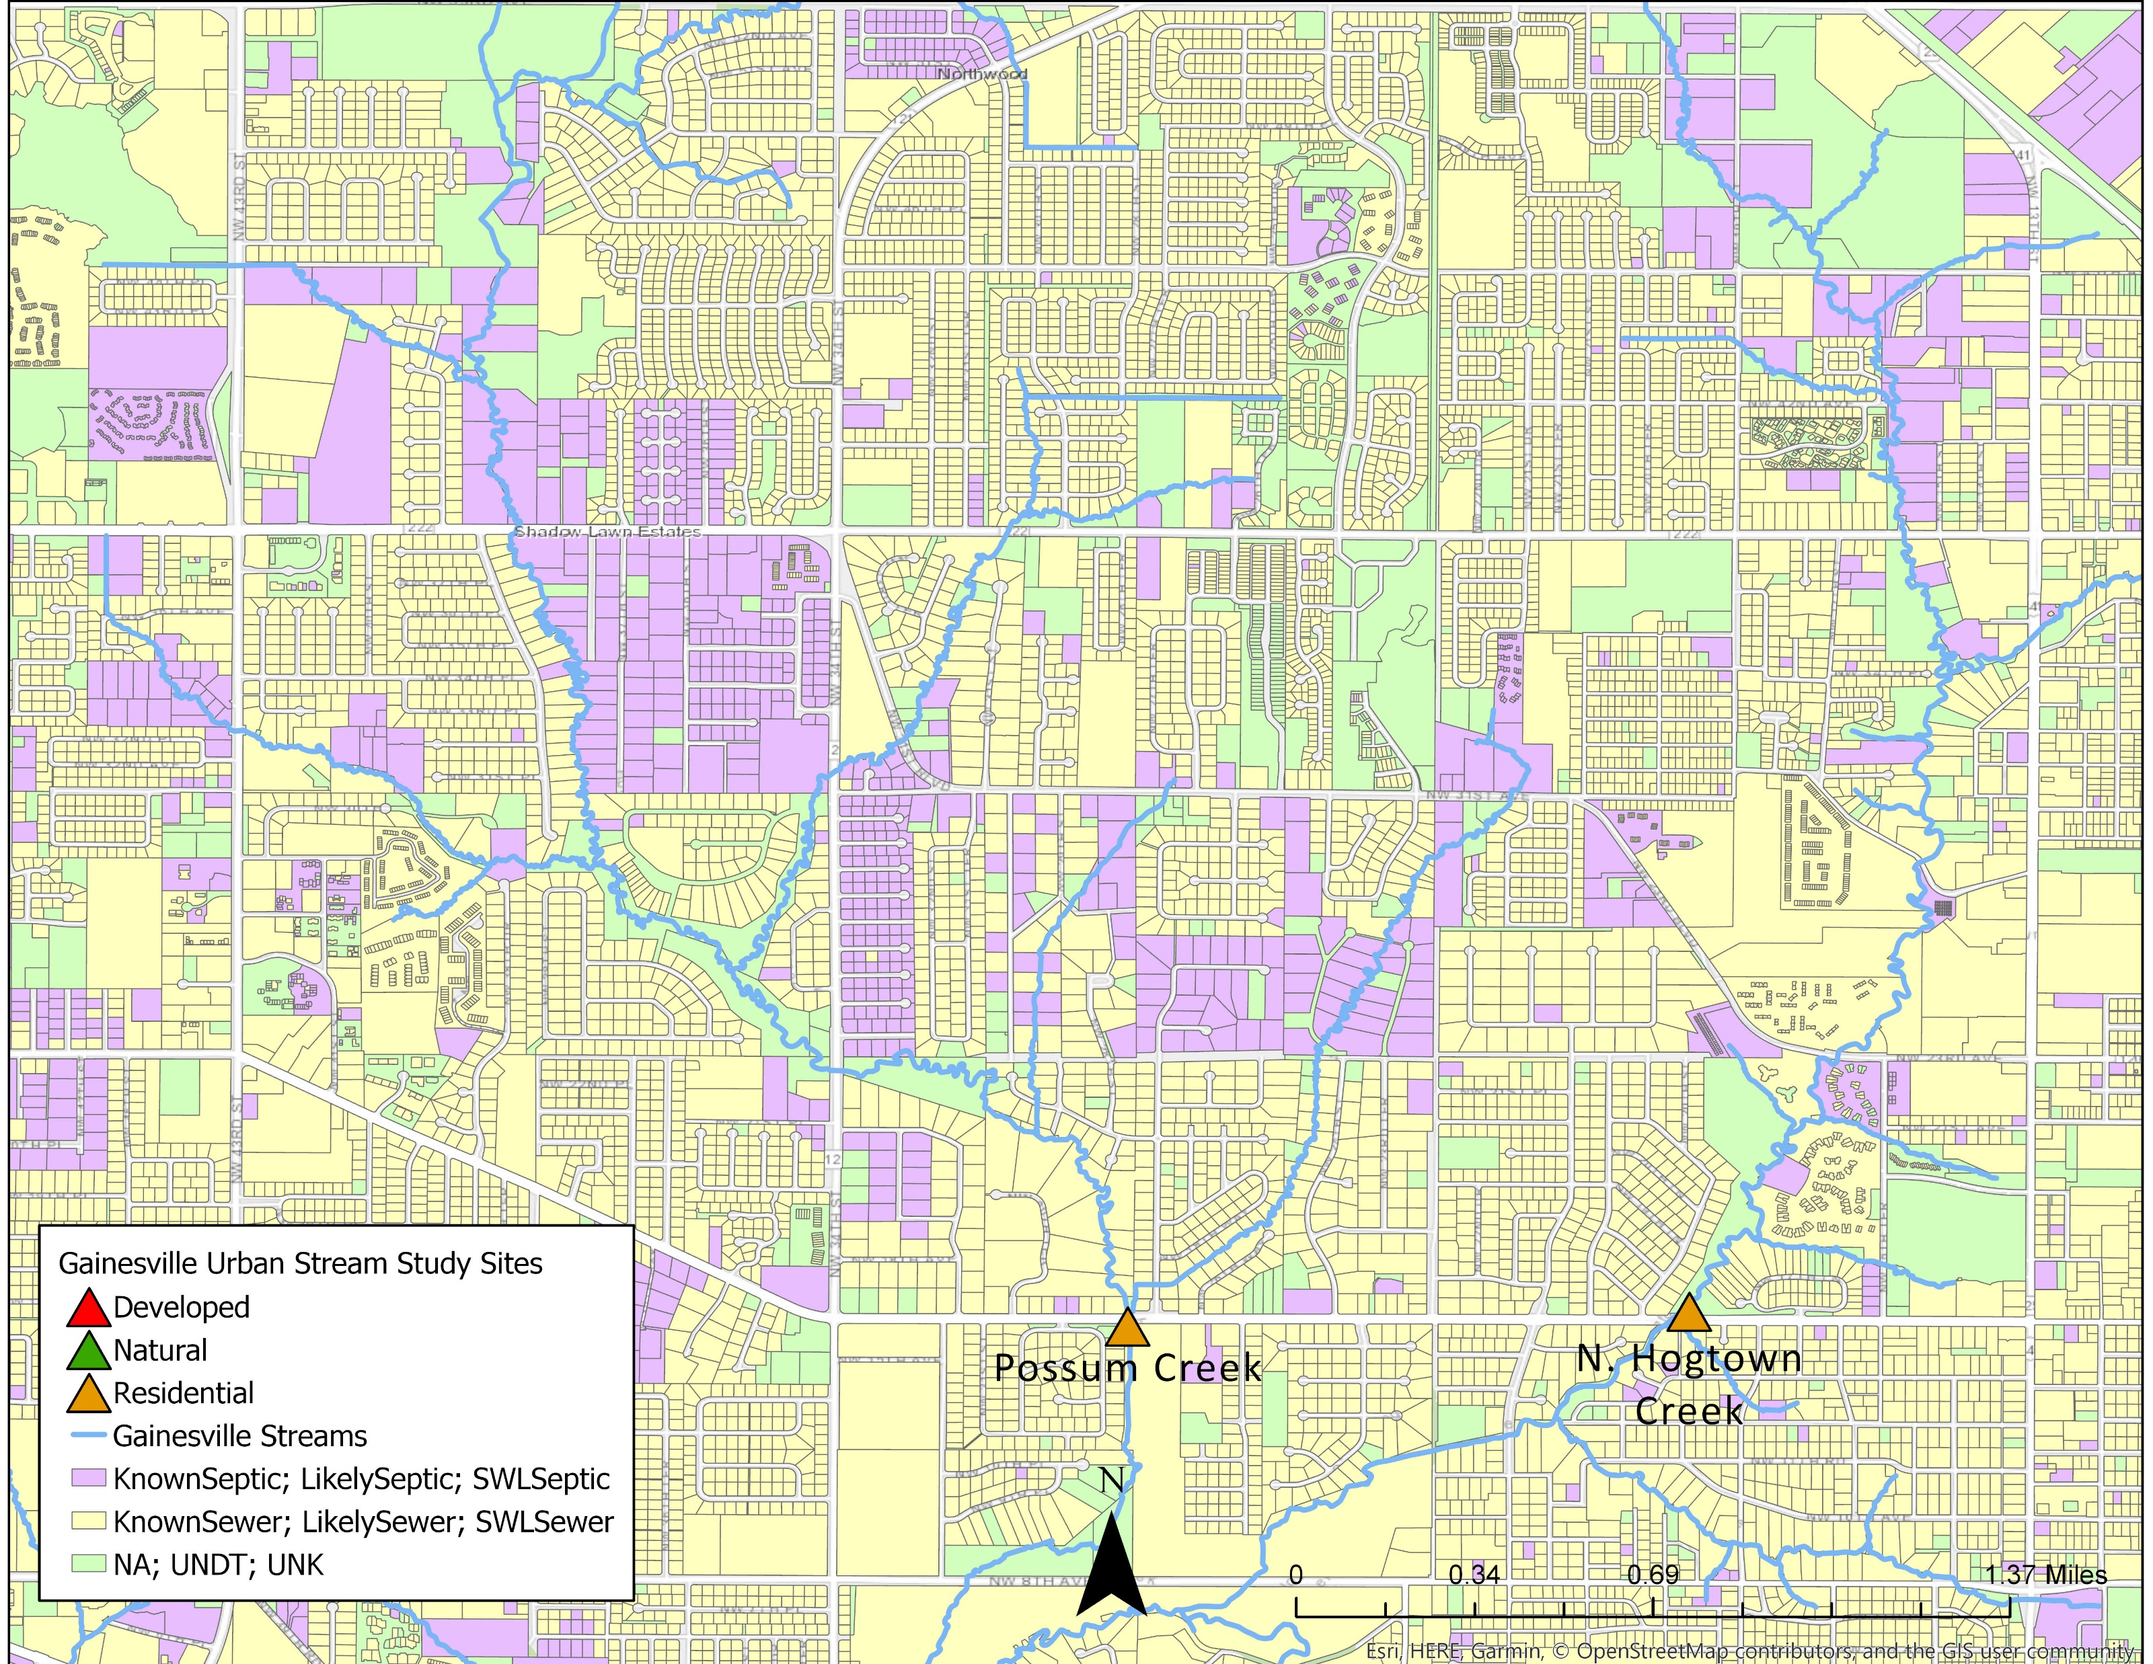
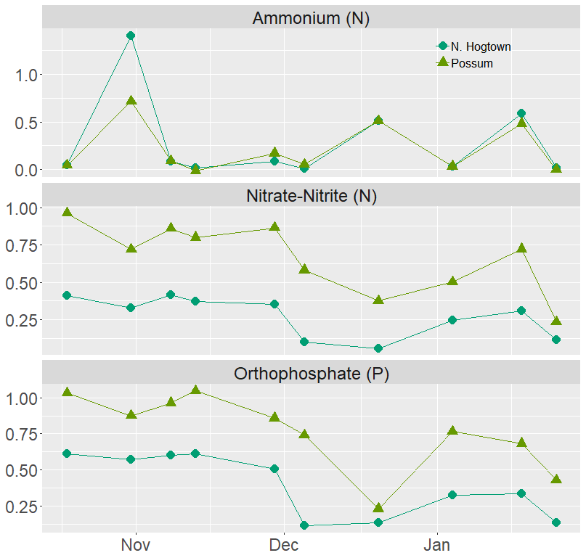
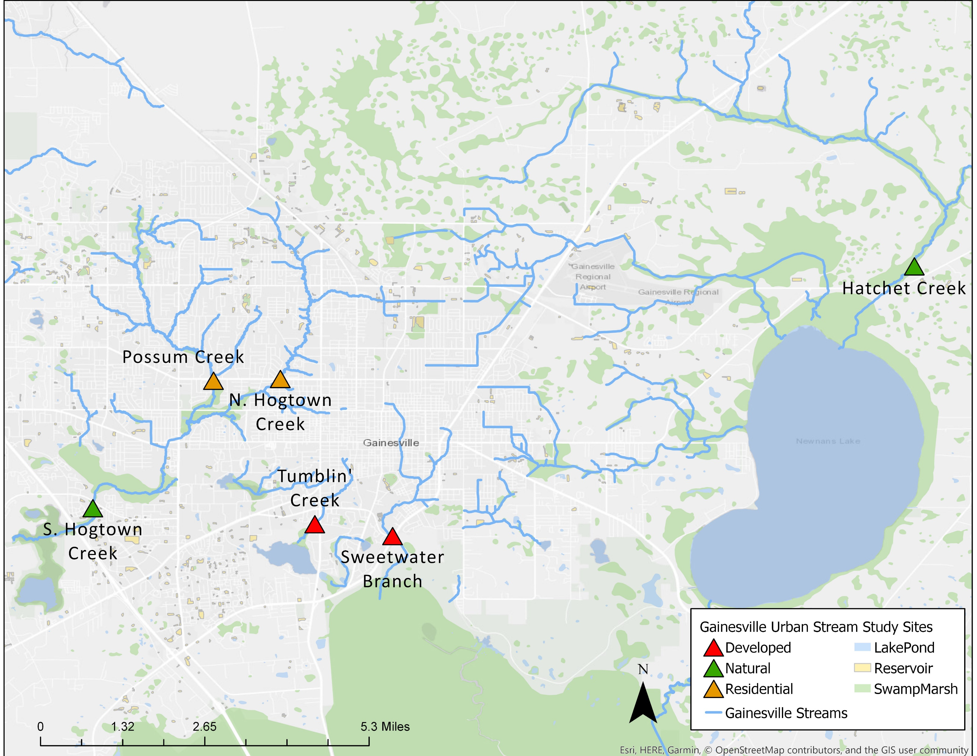
BACKGROUND
RESULTS AND DISCUSSION
Urban development is altering the hydrology and water chemistry of streams through changes in watershed land cover, chemical inputs, biological responses.
Tumblin’ Creek, a concrete-lined channel, regularly exhibits the highest concentrations of dissolved oxygen and pH, suggesting high rates of primary productivity
Sweetwater Branch located downstream from a wastewater treatment plant receives effluent discharge as evidenced by the high specific conductivity readings.
Preliminary results show high variability of nutrient concentrations within and among sites.
Ammonium and nitrate increase with urbanization, likely due to anthropogenic sources.
Due to Florida’s unique geology, ortho-phosphate concentrations could be explained by natural sources.
The most urbanized site has some of the lowest and most stable nutrient concentrations.
Wastewater management practices
(i.e. septic or sewer systems)
Variable residential housing densities and landscape management practices
Changes or loss in biodiversity
Loss of riparian zones
Rapid and intense responses to storm events
Increased impermeable surfaces
Changes in streambed composition
Figure 3. Period-of-record field parameter results across study sites
Figure 4. Period-of-record nutrient concentrations across study sites
Figure 1. Potential drivers of changes in urban stream ecosystems
Streams illustrated unique signatures under baseline conditions. Radar plot comparisons between analytes (Figure 5) were used to show dominating drivers and variability in and among study sites.
HYPOTHESIS & OBJECTIVES
NATURAL
RESIDENTIAL
DEVELOPED
Through regular monitoring of six streams in North-Central Florida spanning a landscape gradient encompassing variability in land-use, stream bed compositions, and nutrient input sources, we hope to:
gain a broader understanding of how urban landscapes shape nutrient fluxes in urban streams,
capture short- and long-term effects of the stormwater, land, and wastewater management strategies used in our study region,
provide information on practices affecting water quality,
and provide insight for alternative strategies to minimize the impact of urbanization on downstream water quality.
We hypothesize that streams with more urbanized watersheds will exhibit both higher mean nutrient concentrations as well as greater temporal variability due to changes in hydrology and nutrient sources.
Figure 5. Radar plots of stream chemical compositions exhibiting urban stream signatures
Comparison of two residential streams with different wastewater management practices highlight importance of landscape management
Figure 6. Surveyed sewer and septic systems for the contributing waters of Hogtown and Possum Creek.
Figure 7. Timeseries data of nutrient concentrations for Hogtown and Possum Creek
CONCLUSIONS & FUTURE RESEARCH
Stream signatures of less developed streams show less influence by any one factor, while increasingly urban streams show higher influence over multiple factors.
Nutrient concentration variability exists within and among each station but less so in our most urbanized stream
Wastewater management practices appear to be a driver in nutrient variability across site
Continued work will include continuous whole stream metabolism, dissolved organic matter analysis, and watershed delineation and analysis
Figure 2. Six monitoring locations in N. Central Florida which include two heavily urbanized, two residential, and two protected streams.
METHODS
Bi-weekly sampling of water quality field parameters include temperature (ºC), dissolved oxygen (mg/L and percent saturation), specific conductance (uS/cm), pH (SU), and turbidity (NTU). Triplicate water quality samples were field filtered and analyzed using a Seal AQ 400 Discrete Analyzer for nitrate-nitrite as N (mg/L), ortho-phosphate as P (mg/L), and ammonium as N (mg/L).
ACKNOWLEDGEMENTS
This research is funded in-part by the Center for Landscape Conservation and Ecology with logistical support provided by Alachua County Environmental Protection Department, the City of Gainesville, and the St. John’s River Water Management District.
Special thanks to Hallie Ferguson, Lindsey Kelly, Dr. Mark Clark, Dr. Eban Bean, Piyush Agade, and Steve Hohman for their advice, assistance, and support.

